Slide 2
Unit Objectives
Plan the page layout
Create the head content
Set web page properties
Create and format text
Add links to web pages
Use the History panel
View HTML code
Test and modify web pages

Slide 3
Planning the Page Layout
Keep it simple
Use white space effectively
Limit media objects
Use an intuitive navigation structure
Apply a consistent theme using templates
Use CSS for page layout
Be conscious of accessibility issues

Slide 4
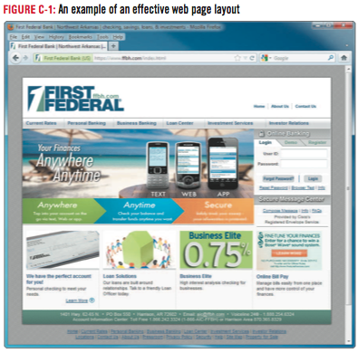
Planning the Page Layout

Slide 5
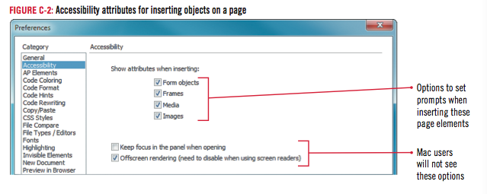
Planning the Page Layout

Slide 6
Design Matters
Designing for accessibility
It is extremely important to design your website so that individuals with disabilities can successfully navigate and read its web pages
POUR principles. Websites should be:
Perceivable
Operable
Understandable
Robust

Slide 7
Creating the Head Content
Start Dreamweaver, click the Site list arrow on the Files panel
Then click The Striped Umbrella if not already selected
Double-click index.html; make sure the Document window is maximized
Click View on the Menu bar
Click Head Content if necessary
Click the Title loon
Please the insertion point after The Striped Umbrella in the Title text box in the Property Inspector
Press [spacebar], type beach resort and spa, Ft. Eugene, Florida, then press [Enter] (Win) or [return] (Mac)

Slide 8
Creating the Head Content
Expand the Insert panel if necessary, click the Insert panel list arrow
Then click the Common category (if necessary), scroll if necessary to locate the Head object, then click the Head button list arrow
Click Keywords, type specified keywords (including the commas) in the Keywords text box, then click OK
Click the Head button list arrow on the Insert panel, click Description
Then type The Striped Umbrella is a full-service resort and spa just steps from the Gulf of Mexico in Ft. Eugene, Florida. in the Description dialog box, then click OK

Slide 9
Creating the Head Content
Click the Show Code view button on the Document toolbar, click anywhere in the code, then view the head section code
Click the Show Design View button on the Document toolbar, click View on the Menu bar, then click Head Content

Slide 10
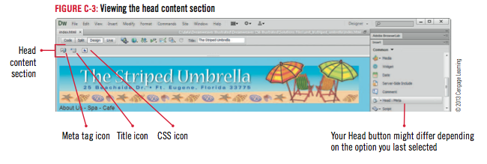
Creating the Head Content

Slide 11
Creating the Head Content

Slide 12
Setting Web Page Properties
Click Modify on the Menu bar, then click Page Properties
Click the Background color box
Click the blue color swatch, #9CF (the fifth color in the last row)
Click Apply in the Page Properties dialog box

Slide 13
Setting Web Page Properties
Click next to Background color, click the white color swatch (the rightmost color in the bottom row), then click Apply
Click the Text color box, then use the eyedropper tool to select a light shade of blue, then click Apply
Click next to Text color, then click the Default Color Icon at the top of the color picker
Click OK

Slide 14
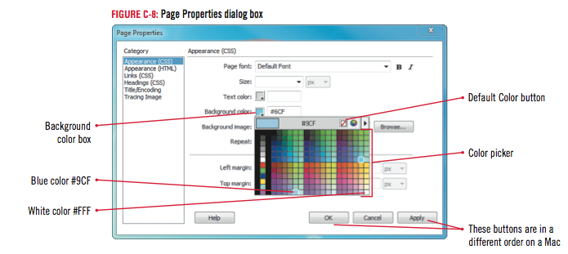
Setting Web Page Properties

Slide 15
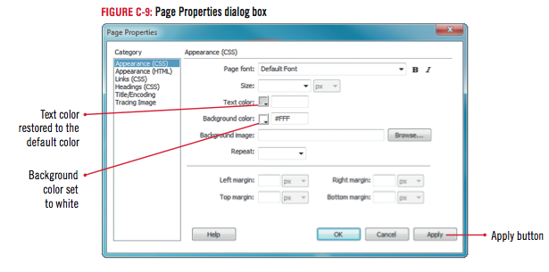
Setting Web Page Properties

Slide 16
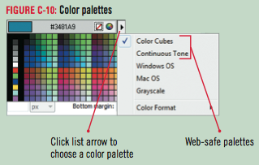
Design Matters
Choosing Colors to Convey Information
Web-safe color palette: a set of colors that appears consistently in all browsers and on Macintosh, Windows, and UNIX platforms

Slide 17
Creating and Formatting Text
Position the insertion point to the left of A in About Us, then drag to select About Us – Spa – Café
Type Home - About Us - Spa - Cafe - Activities, with spaces in between
Position the insertion point at the beginning of the first paragraph, type Welcome to our beach! then, press [Enter] (Win) or [return] (Mac)
Click anywhere in the “Welcome!” text you just entered, click the HTML button on the Property inspector to open the HTML Property inspector if necessary, click the Format list arrow in the HTML Property inspector, then click Heading 1

Slide 18
Creating and Formatting Text
Position the insertion point after the period following “…want to go home”, press [Enter] (Win) or [return] (Mac), then type The Striped Umbrella
Press and hold [Shift], press [Enter] (Win) or [return] (Mac) to create a line break
Enter the following information, placing a line break at the end of each line:
25 Beachside Drive
Ft. Eugene, Florida 33775
(555) 594-9458

Slide 19
Creating and Formatting Text
Position the pointer to the left of The Striped Umbrella
Click and drag to select all information entered in Step 7
Click the Italic button in the Property inspector
Then click anywhere to deselect the text

Slide 20
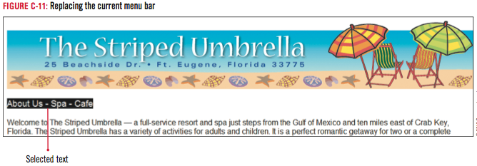
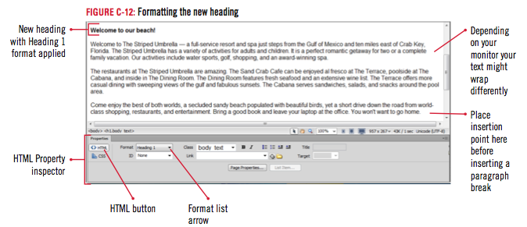
Creating and Formatting Text

Slide 21
Adding Links to Web Pages
Double-click Home in the menu bar
Click the Browse for File icon next to the Link text box in the HTML Property inspector, then navigate to the striped_umbrella root folder
Click index.html, verify that Document is selected in the Relative to pop-up menu, then click OK (Win) or Open (Mac)
Repeat steps 1-4 to create links for About Us, Spa, Cafe, and Activities, using about_us.html, spa.html, cafe.html, and activities.html as the corresponding files, then click anywhere on the page
Click anywhere on the home page to deselect Home

Slide 22
Adding Links to Web Pages
Position the insertion point immediately after the last digit in the telephone number, press and hold [Shift], then press [Enter] (Win) or [return] (Mac)
Click the Insert panel list arrow, click Common if necessary, then click Email Link
Type Club Manager in the text box, press [Tab], then type manager@thestripedumbrella.com in the E-Mail text box, click OK
If link is not italicized, position the pointer left of Club Manager, click/drag to select text, click the Italic button, then click anywhere to deselect the text

Slide 23
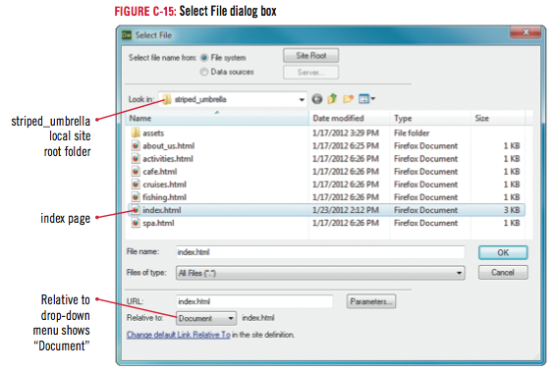
Adding Links to Web Pages

Slide 24
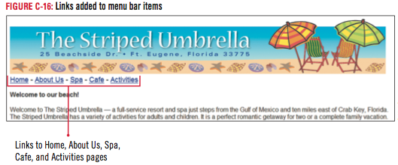
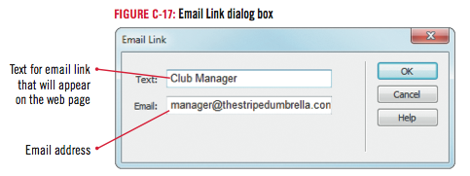
Adding Links to Web Pages

Slide 25
Using the History Panel
Click Window on the Menu bar, then click History
Click the Panel menu on the History panel title bar, click Clear History, then click Yes in the Dreamweaver warning box
Position the insertion point to the left of the words Welcome to our beach! in the line of text
Click Insert on the Menu bar, point to HTML, then click Horizontal Rule
If “pixels” is not displayed in the width pop-up menu, click the width list arrow in the Property inspector, click pixels, type 950 in the W text box, then press [Enter] (Win) or [return] (Mac)

Slide 26
Using the History Panel
Click the Align list arrow in the Property inspector, then click Left
Select 950 in the W text box, type 80, click the Width list arrow, click %, click the Align list arrow, then click Center
Drag the slider on the History panel up until it is pointing to Set Alignment: left, then release it
Click File on the Menu bar, then click Save

Slide 27
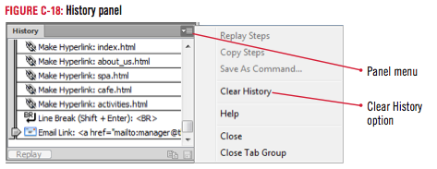
Using the History Panel

Slide 28
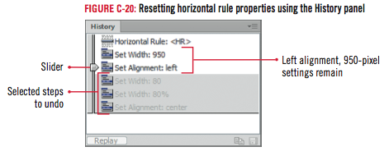
Using the History Panel

Slide 29
Clues to Use
Using the History panel
Undo or redo steps
By dragging the slider up and down in the History panel
Memorizes certain steps
Some Dreamweaver features cannot be recorded in the History panel
Default number of steps recorded is 50
Setting this number higher requires more memory, which may affect speed

Slide 30
Clues to Use
Checking your screen against book figures
They will likely look different
Dreamweaver “remembers” the screen arrangement from your last session
Open, close, collapse, or expand various panels, toolbars, and inspectors to change screen arrangement

Slide 31
Viewing HTML Code
Click Window on the Menu bar, click History to close the History panel, then click the horizontal rule
Click the Show Code view button on the Document toolbar
If necessary, click to select the Line Numbers and Word Wrap option buttons on the Coding toolbar
Click Window on the Menu bar, point to Results
Click Reference
Click the Book list arrow in the Reference Panel to select O’REILLY HTML Reference
Click the Tag list arrow to select HR if necessary
Read the information about horizontal rules

Slide 32
Viewing HTML Code
Click the Panel menu on the Results panel title bar, then click Close Tab Group
Scroll down if necessary in the Document window, select January 1, 2015, then press [Delete]
Scroll down the Common category on the Insert panel until the Date object button appears
Click Date, click March 7, 1974, in the Date format options list
Click the Update automatically on save check box if necessary to select it, then click OK
Click the Show Design view button on the Document toolbar

Slide 33
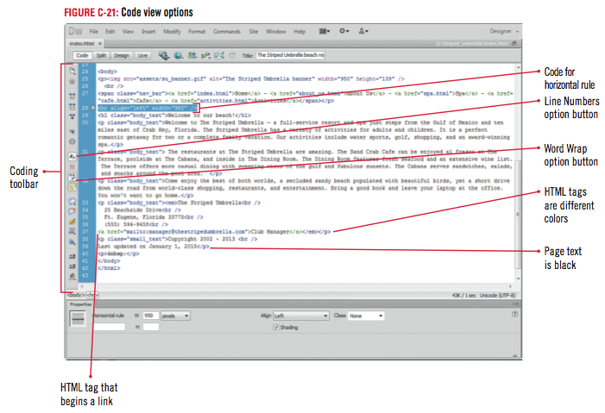
Viewing HTML Code

Slide 34
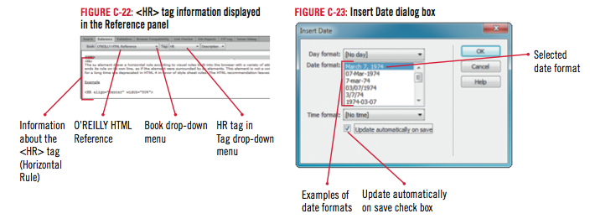
Viewing HTML Code

Slide 35
Testing and Modifying Web Pages
Click the Tablet size button on the Status bar to see how the page would appear on a tablet using the default tablet settings
Click the Desktop size button, scroll down if necessary and highlight the period after the “...go home” text, then type !
Click File on the Menu bar, click Save, click on the Document toolbar, then click Preview in [your default browser]

Slide 36
Testing and Modifying Web Pages
Click the About Us link on the menu bar to display one of the blank pages you created in Unit B, then click the Back button on the Address bar (Win) or the Navigation toolbar (Mac)
Repeat step 4 to test the Spa, Cafe, and Activities links
Click the Club Manager link
Close the email message dialog box, close the browser window, close the index page, then click Exit on the File menu (Win) or Quit on the Dreamweaver menu (Mac) to close the Dreamweaver program

Slide 37
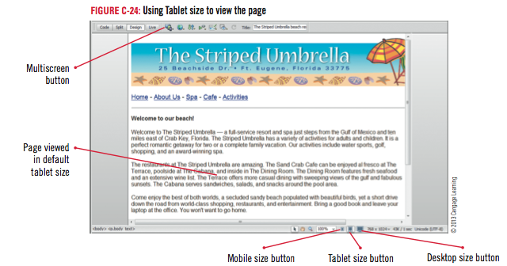
Testing and Modifying Web Pages

Slide 38
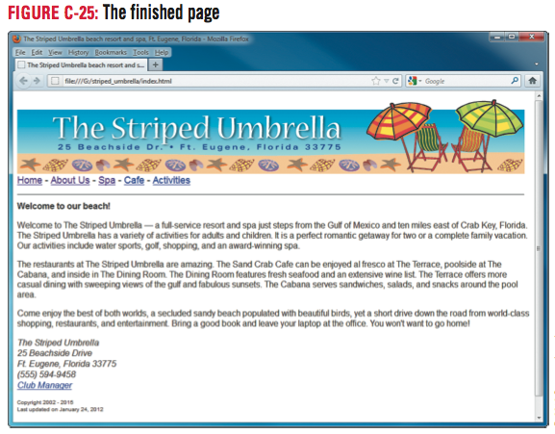
Testing and Modifying Web Pages

Slide 39
Design Matters
Using smart design principles
Horizontal symmetry
Vertical symmetry
Diagonal symmetry
Radial symmetry
Rule of thirds

Slide 40
Unit Summary
Plan the page layout
Create the head content
Set web page properties
Create and format text
Add links to web pages
Use the History panel
View HTML code
Test and modify web pages

